Slide 1



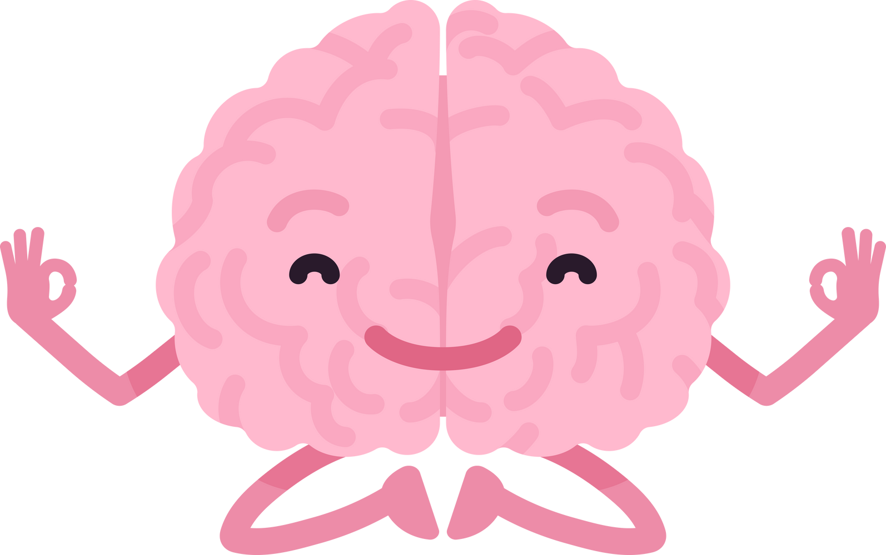
HEALING MINDS
Not All Scars Are Visible

Slide 2
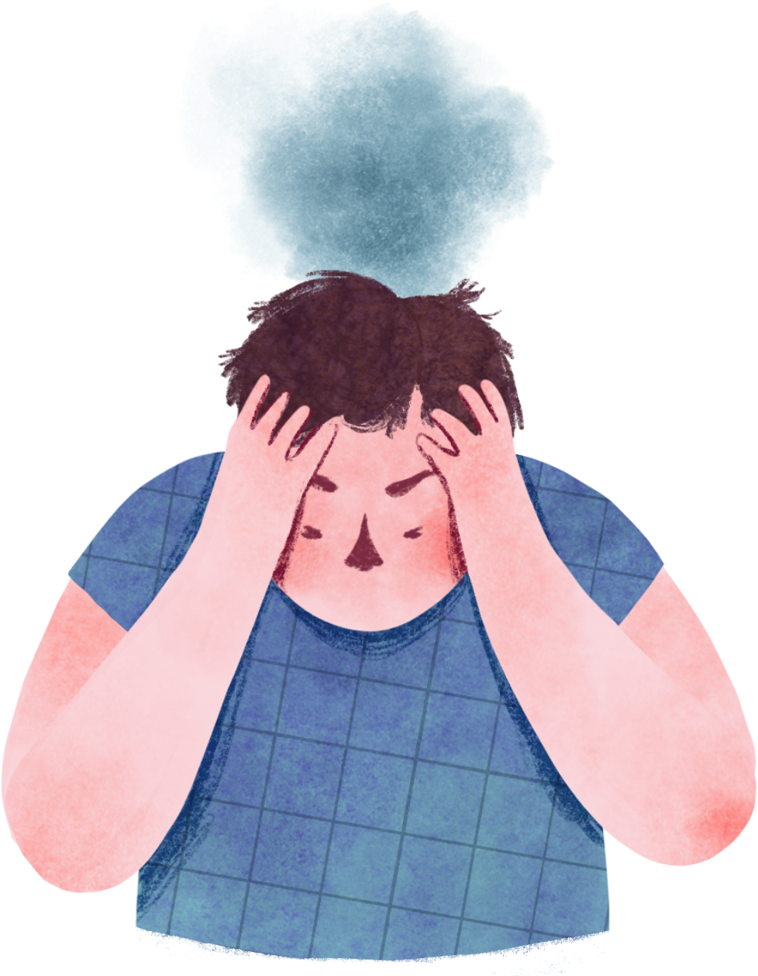

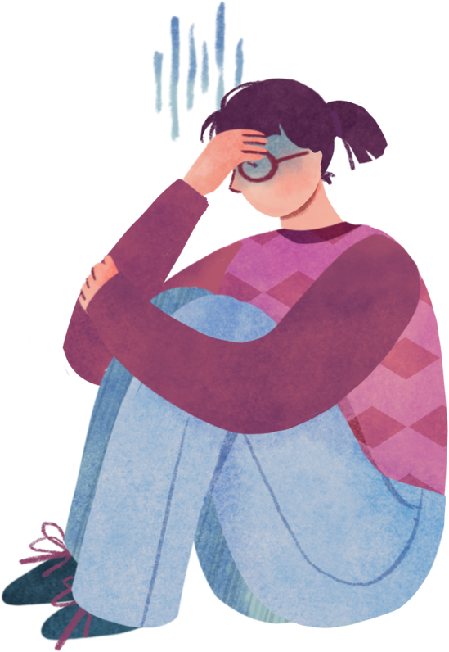

MENTAL HEALTH
Mental health is a positive concept. It encompasses our emotions, our psyche, and our social interactions.
Good mental health is not just about not being sick; it means feeling well in every way. When we are mentally healthy, we can use our skills, handle stress, do good work, and help our community.

Slide 3

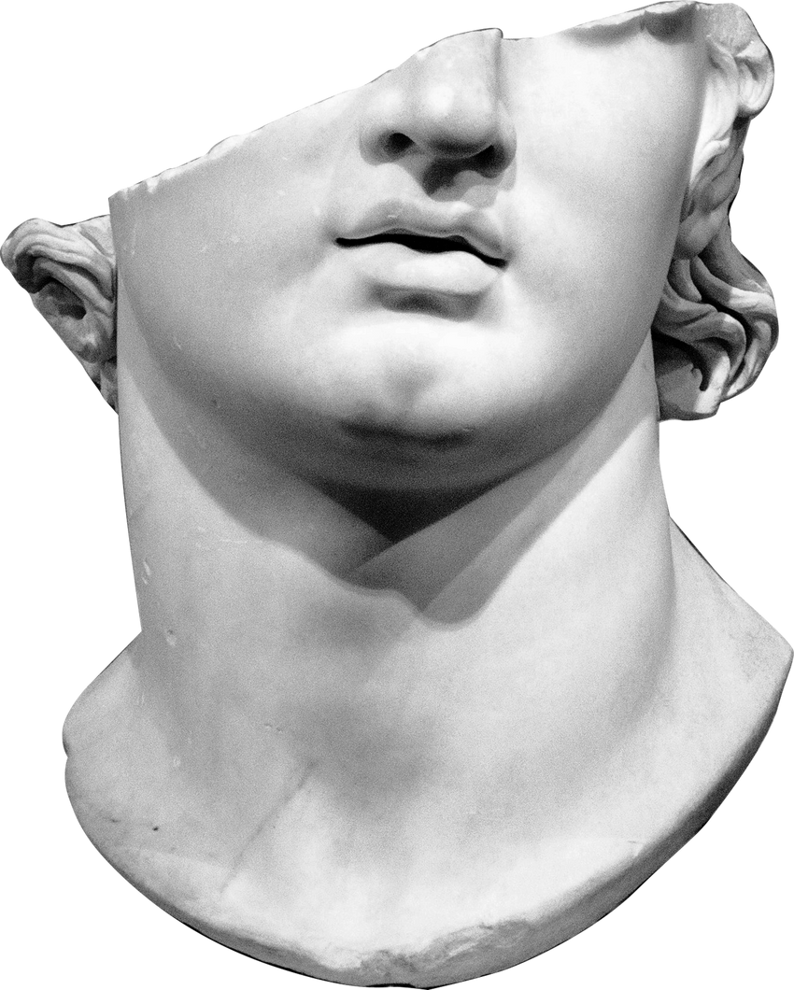
IT IS MORE COMMON THAN YOU THINK
Loneliness declared in pandemic: 1 in 4 adults suffering from it
WHO now looking for those who can treat it
Experts say it leads to 30% higher death risks

Slide 4

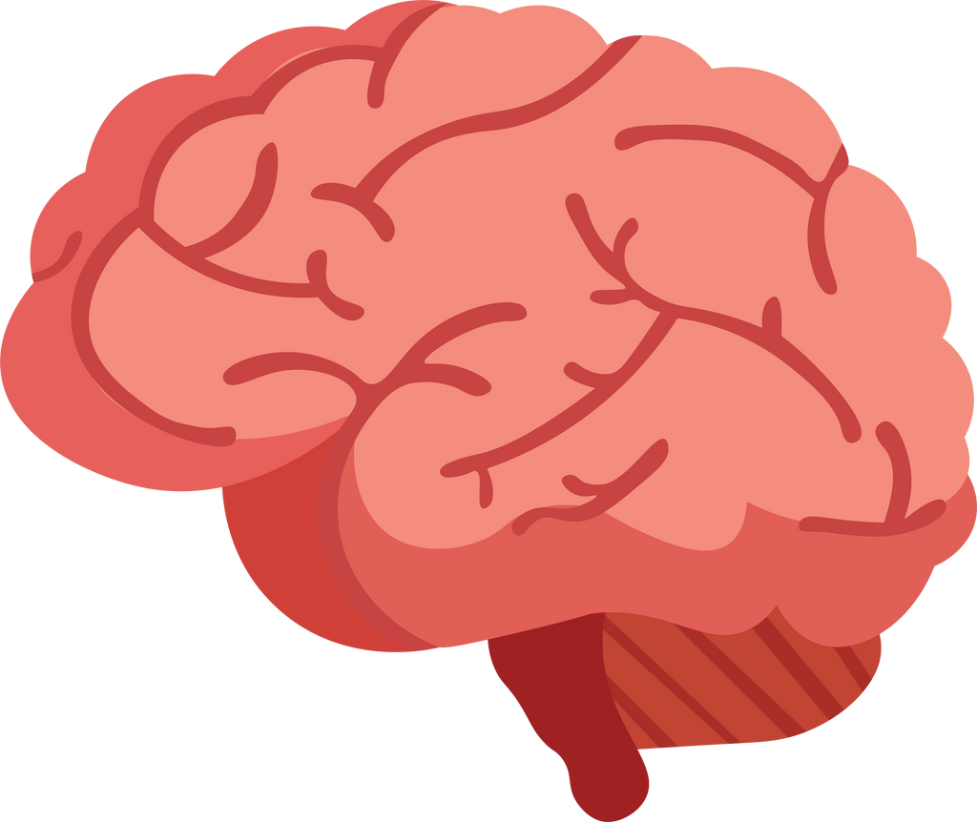
Objective
Our aim is to address the limited access to mental health support and the stigma surrounding mental health issues. People often struggle due to factors like limited access to professionals, fear of stigma, high costs.
We endeavor to achieve this by offering live sessions and mental healthcare advisor bot.

Slide 5
Features
Healing Minds is a mental health and well-being portal that offers an inclusive and anonymous space for individuals seeking support and guidance for their mental health
Live Sessions
Arrange live sessions with licensed professionals, spiritual leaders, and survivors, allowing users to ask anonymous questions and seek guidance on their mental health and well-being.
Virtual Psychiatrist
Develop a chatbot with voice and text recognition capabilities, supporting multiple languages to provide instant responses and resources for users' mental health concerns.
Self Learning
Provides platform to learn about your mental health as we know mental health is as important as physical health.
Professional Help
Seek professional help from best known psychiatrists in the country.
Finding Friend
Provides a platform to find a friend with similar issues and chat with them.

Slide 6
Techstacks
For Frontend:
React.js
For Chatbot:
Python
NLTK (Natural Language Toolkit)
Keras Sequential model
Stochastic Gradient Descent algorithm (SGD)
For Backend:
Firebase
Flask
Javascript
Python

Slide 7

Workflow
User Registration:
User register himself by email, password, state and city
Browsing Resources:
Users can explore articles, videos, and self-help tools for self-guided support
Chatbot Support:
A chatbot provides instant responses and resources in languages
Live Session Scheduling:
Users can attend scheduled live sessions and real-time with appropriate professionals
Professional Help:
Provides best professionals details
Finding Friend:
Helps you find friends nearby who share same mental condition

Slide 8

Future scope
Augmented reality meditation sessions
Anonymous Profile creation
MedPaLM integration for better accuracy
Patient improvement rate
and mental health prediction by assessments

Slide 9
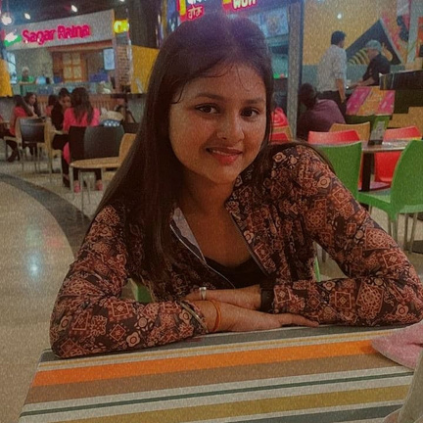

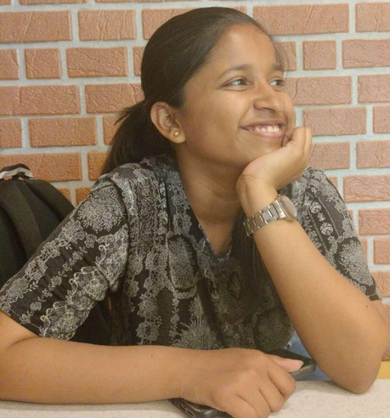
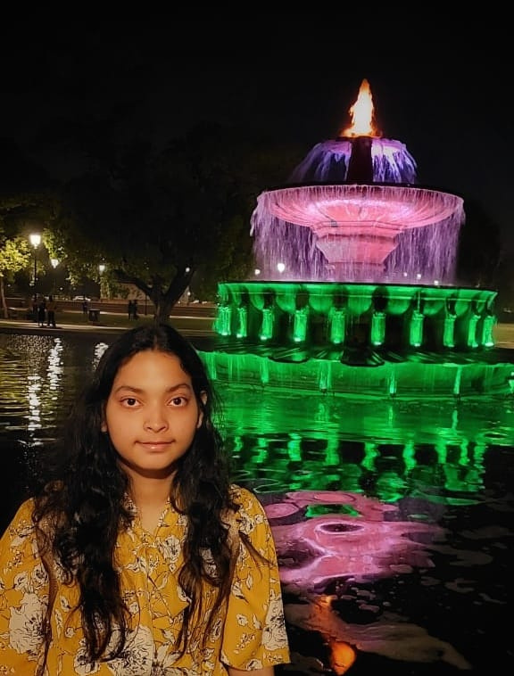
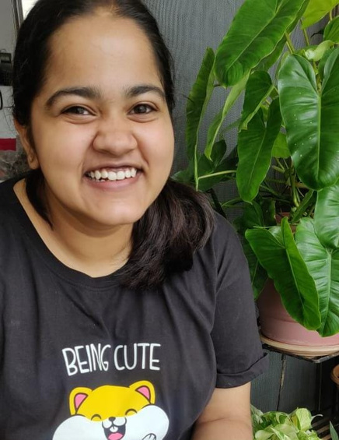
Sampada
Agarwal
Aastha
Jain
Team TAMS
Tarang
Priyadarshi
Mahi

Slide 10

Thank You

